Slide 1


Algorithms Design and Analysis
算法设计与分析
山东大学软件学院 2023

Slide 2
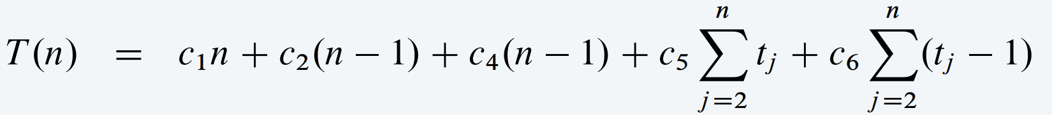
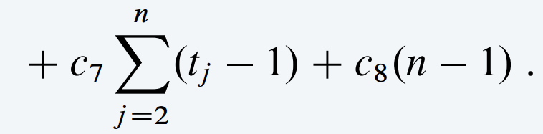
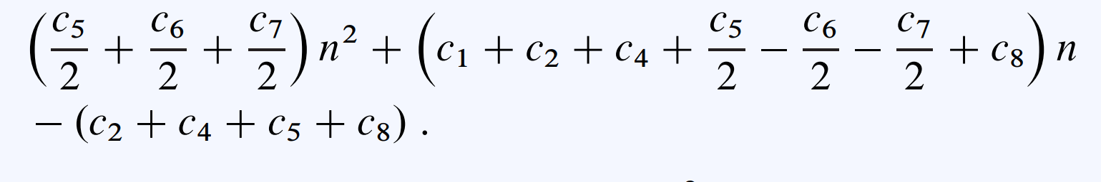
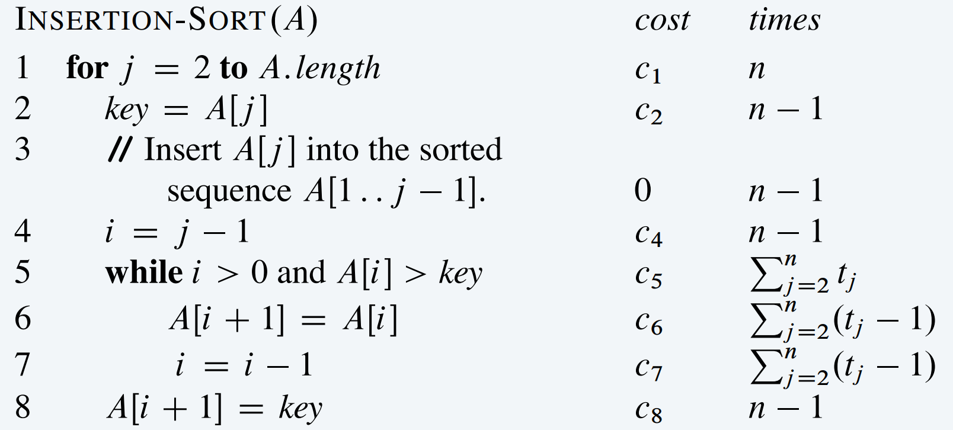


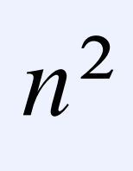
Chapter 3 Growth of functions
Recall the rate of growth of the running-time of INSERTION-SORT.
Rate of growth.
rate of growth of T(n)
Asymptotic efficiency of algorithms.
A simple characterization of the algorithm’s efficiency.

Slide 3


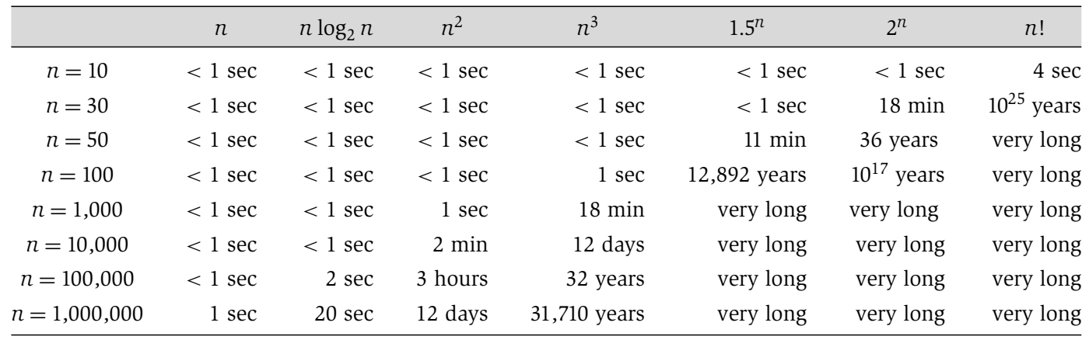
Growth of functions
polynomial time
non-polynomial time

Slide 4
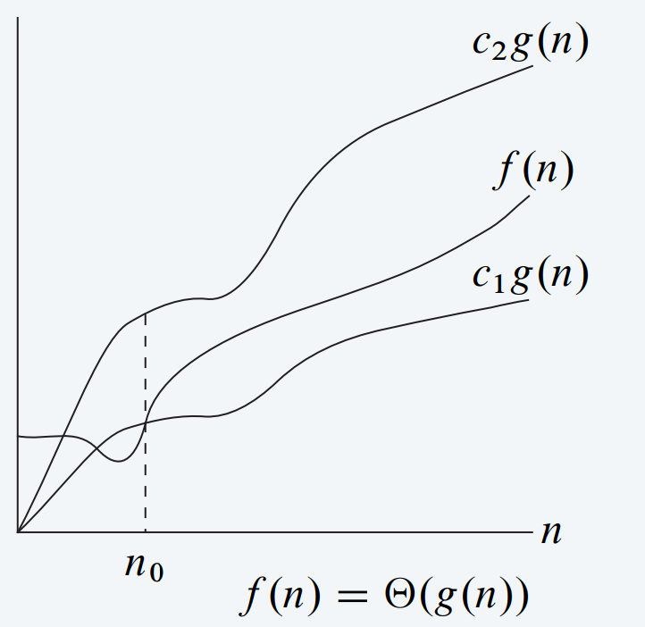
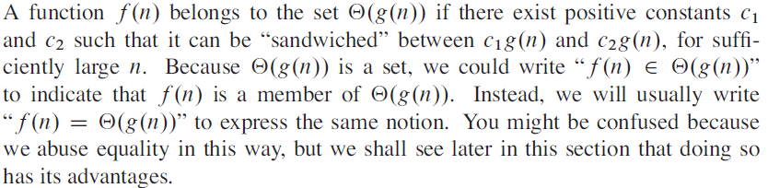
Big Θ notation —— asymptotically tight bound
Tight bounds.
Ex. f (n) = 32n² + 17n + 1.
f (n) is Θ(n²).
choose c1 = 32, c2 = 50, n0 = 1
f (n) is neither Θ(n) nor Θ(n³).

Slide 5



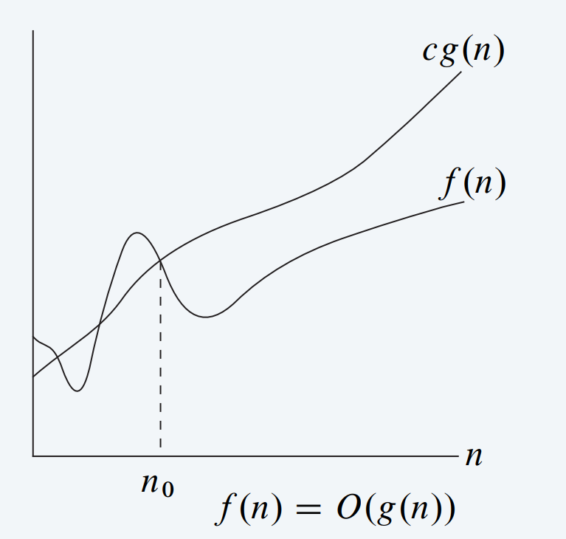
Big O notation——asymptotic upper bound
Upper bounds.
Computer scientists often write f (n) = O(g(n)) instead of f (n) ∈ O(g(n)).
：
Ex. f (n) = 32n² + 17n + 1.
f (n) is O(n²).
choose c = 50, n0 = 1
f (n) is neither O(n) nor O(n log n).
Ex. Consider f ₁(n) = 5n³ and f ₂(n) = 3n².
We have f ₁(n) = O(n³) and f ₂(n) = O (n³).
But, do not conclude f ₁(n) = f ₂(n).
Why？

Slide 6

quiz
Let f(n) = 3n² + 17 n log₂^{n} + 1000. Which of the following are true?
f (n) is O(n²).
f (n) is O(n³).
Both A and B.
Neither A nor B.
choose c = 1020, n0 = 1
choose c = 1020, n0 = 1

Slide 7
Big O notation: properties
Reflexivity.
f is O( f ).
Products. If f 1 is O(g1) and f 2 is O(g2), then f 1 f 2 is O(g1 g2). Pf.
∃ c₁ > 0 and n₁ ≥ 0 such that 0 ≤ f 1(n) ≤ c1 · g1(n) for all n ≥ n₁.
∃ c₂ > 0 and n₂ ≥ 0 such that 0 ≤ f 2(n) ≤ c2 · g2(n) for all n ≥ n₂.
Constants. If f is O(g) and c > 0, then c f is O(g).
Sums. If f 1 is O(g1) and f2 is O(g2), then f 1 + f 2 is O(max {g1, g2}).
ignore lower-order terms
Transitivity. If f is O(g) and g is O(h), then f is O(h).
Ex. f (n) = 5n³ + 3n² + n +1234 is O(n³).

Slide 8
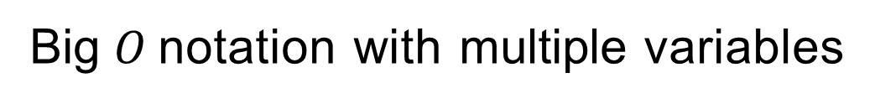
Big $O$notation with multiple variables
Upper bounds. f (m, n) is O(g(m, n)) if there exist constants c > 0, m₀ ≥ 0, and n₀ ≥ 0 such that f (m, n) ≤ c · g (m, n) for all n ≥ n₀ and m ≥ m₀.
Ex. f (m, n) = 32mn² + 17mn + 32n³.
f (m, n) is both O(mn² + n³) and O(mn³).
f (m, n) is neither O(n³) nor O(mn²).
Typical usage. Breadth-first search takes O(m + n) time to find a shortest path from s to t in a digraph with n nodes and m edges.

Slide 9
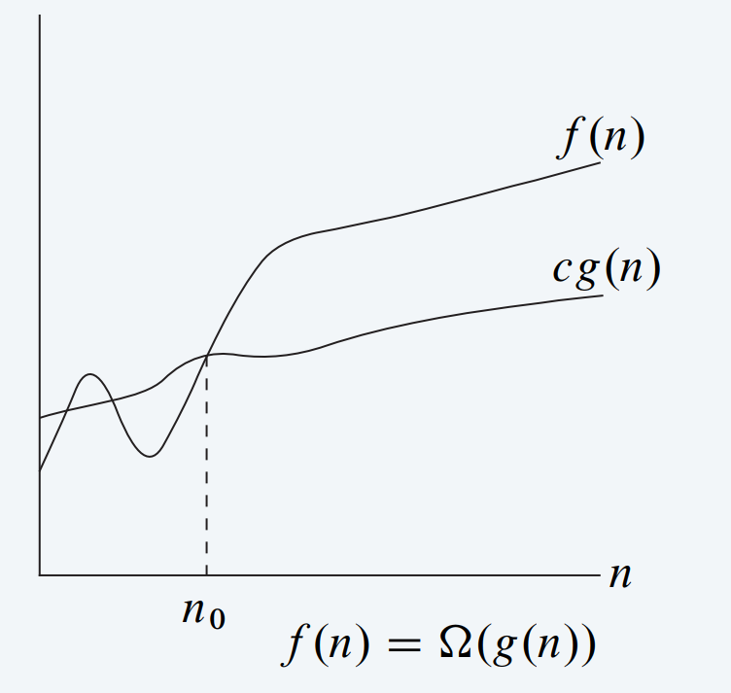
Big Ω notation
Lower bounds.
Ex. f (n) = 32n² + 17n + 1.
f (n) is both Ω(n²) and Ω(n).
f (n) is not Ω(n³).
choose c = 32, n0 = 1

Slide 10
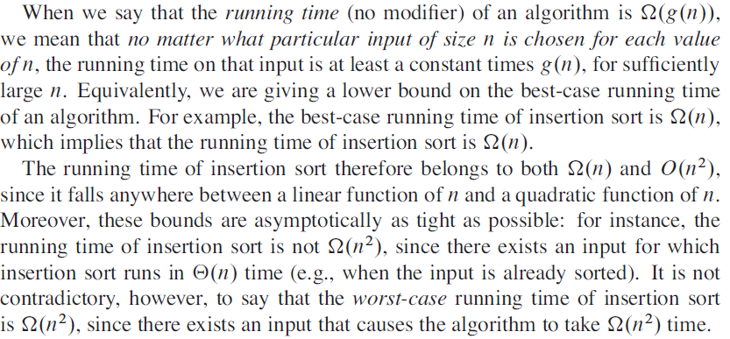
Big Ω notation
Lower bounds.

Slide 11
quiz
Which is an equivalent definition of big Omega notation?
A. f (n) is Ω(g(n)) iff g (n) is O( f (n)).
B. f (n) is Ω(g(n)) iff there exist constants c > 0 such that f (n) ≥ c · g(n) ≥ 0
for infinitely many n.
C. Both A and B.
D. Neither A nor B.

Slide 12

Big Θ notation
含义：
对所有的n≥n₀，函数f(n)在一个常数因子内等价于g(n)。
称g(n)是f(n)的一个渐进紧确界(asymptotically tight bound )
从算法时间复杂度的角度看，就是算法在最好和最坏情况下的计算时间就一个常数因子范围内而言是相同的。可看作：
既有 f(n) = Ω(g(n))，又有f(n) = Ο(g(n))
即，g 既是f 的下界，又是f 的上界。
Therefore, can the insertion algorithm use Θ to represent the time complexity?

Slide 13

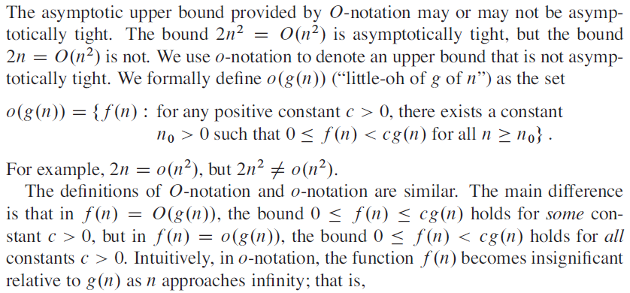
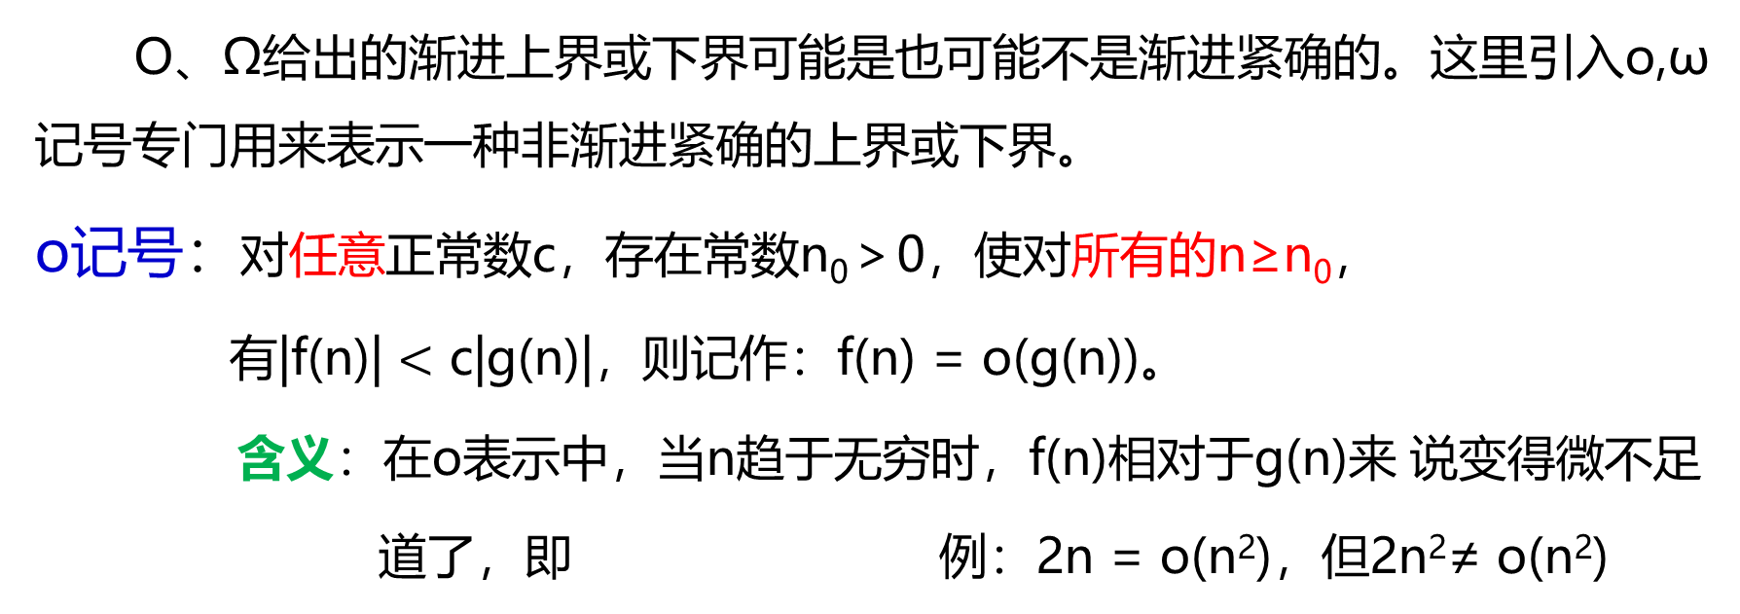
o,ω notations
这句话怎么理解？
O、Ω给出的渐进上界或下界可能是也可能不是渐进紧确的。这里引入o,ω记号专门用来表示一种非渐进紧确的上界或下界。
o记号：对任意正常数c，存在常数n₀＞0，使对所有的n≥n₀，
有|f(n)| $<$ c|g(n)|，则记作：f(n) = o(g(n))。
含义：在o表示中，当n趋于无穷时，f(n)相对于g(n)来 说变得微不足道了，即 例：2n = o(n²)，但2n²≠ o(n²)

Slide 14

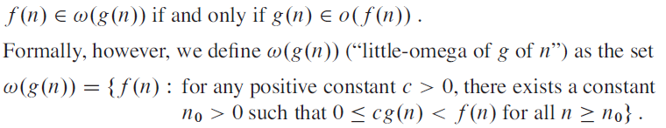
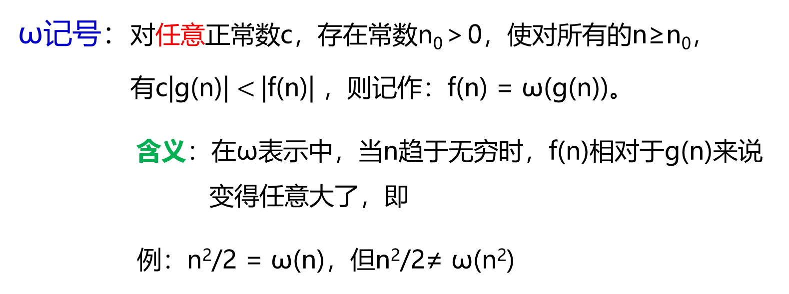
o,ω notations
ω记号：对任意正常数c，存在常数n₀＞0，使对所有的n≥n₀，
有c|g(n)| $<$|f(n)| ，则记作：f(n) = ω(g(n))。
含义：在ω表示中，当n趋于无穷时，f(n)相对于g(n)来说变得任意大了，即
例：n²/2 = ω(n)，但n²/2≠ ω(n²)

Slide 15
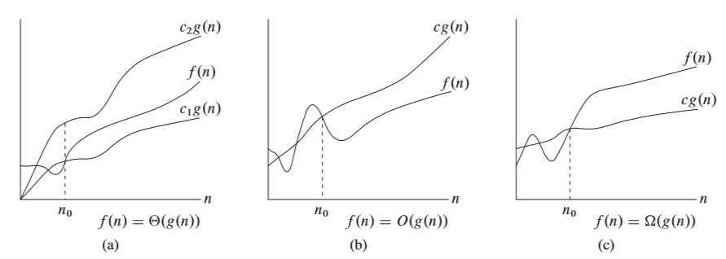
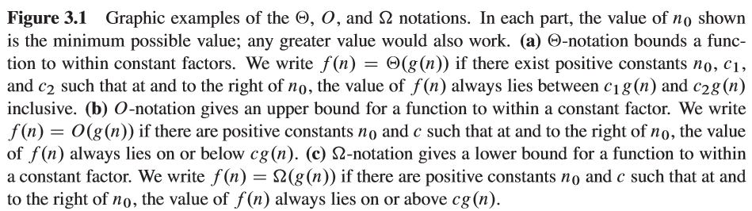
notations

